Slide 1
Advocacy Does Work!
Durham Deaf Accessibility Committee (DDAC)
2007-2012
DDAC Committee

Slide 2
Agenda
12:30 – 1:00 – Guided Tour of the Abilities Centre
1:00 – 2:00 – DDAC Presentation & Groupwork
2:00 – 2:15 – BREAK
2:15 – 3:15 – DDAC Groupwork
3:15 – 4:00 – Presentation on OIS Changes – Bev Dooley, CHS.

Slide 3
DDAC Mandate
What does DDAC do?
Advocate
Promote issues about accessibility
Help the public to take action to improve accessibility
Work with local municipalities, all levels of government, public an private agencies to improve accessibility
Our goal is to improve the quality of life for Deaf and hard of hearing people
Notes:
The Durham Deaf Accessibility Committee (DDAC) will promote, advocate and assist the public in developing and facilitating strategies and actions toward a communication barrier-free Durham Region which includes interacting with local municipalities, all levels of government, as well as public and private agencies, with the goal to of improving the quality of life for those who are Deaf or hard of hearing.

Slide 4
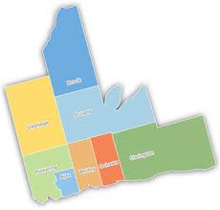
Who Are We?
Committee members are from the Durham Region: Oshawa, Whitby, Ajax, Pickering, Bowmanville (Clarington), Port Perry etc.
Committee members are:
Mike Finnegan (Chair - Whitby)
Don Kinsley (Oshawa)
Gordon Ryall (Oshawa)
Bev Dooley (Whitby)
Bryan Meany (Courtice)
Kim Reid (Oshawa)
Mirek Swiecicki (Newcastle)
Robert Lang (Bowmanville)
Veronica Bickle (Ajax)
Behishta Mushtaq (Whitby)
Maggie Doherty-Gilbert (CHS)
Kim Nicholson (CHS)
Brock
Uxbridge
Scugog
Clarington
Oshawa
Pickering
Ajax
Whitby

Slide 5
How did we get started?
New law in Ontario requiring all homeowners to have smoke alarms in their homes in 2007.
Oshawa Fire Department was starting to visit people’s home to check if they had smoke alarms in their homes. A lot of Deaf people were concerned about this because visual smoke alarms are expensive.
It was decided to set up a committee to advocate for affordable visual smoke detectors.
The first meeting was in June 2007.

Slide 6
DDAC’s Priorities
In the beginning, we focused only on advocating for better fire safety but we started to focus on other topics.
Our priorities for 2013:
Visual smoke alarms
Information Event for the Deaf Community
School Boards
Hospitals

Slide 7
DDAC vs. Local Accessibility Advisory Committees
AODA requiring to have local Accessibility Advisory Committee in each town/city. In Durham, there is 8 of them.
Not enough interpreters.
Do better with our own group due to common language used; strong network and better focus of identifying issues and solutions.
More flexibility to decide our priorities and more time to focus on Deaf issues.
DDAC advises and lobbies its needs.

Slide 8
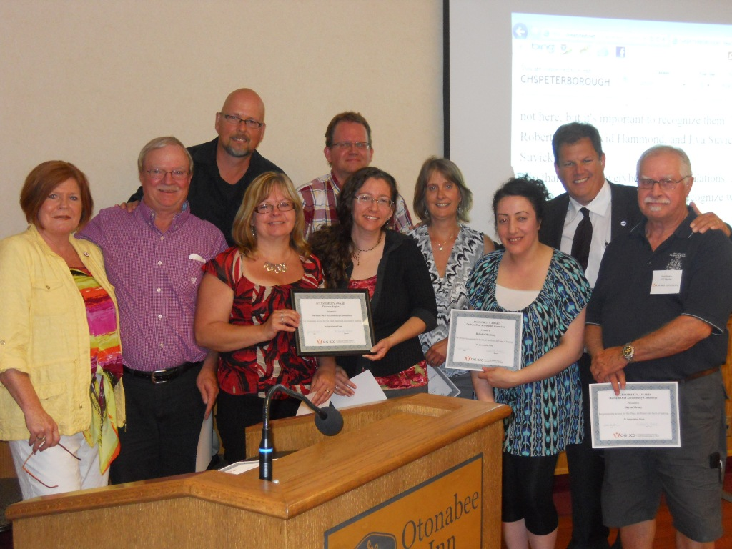
We Received an Award!
CHS Peterborough/Durham Accessibility Award – June 2012

Slide 9
Our Accomplishments!
Recognition from Local Accessibility Committees
Bowmanville Lions Club donated $2,000 in 2008.
Meeting with the Fire Marshal of Ontario and participated in the Public Fire Safety Council. Participated in various fire safety events i.e. Fire Prevention Officers Trade Show.

Slide 10
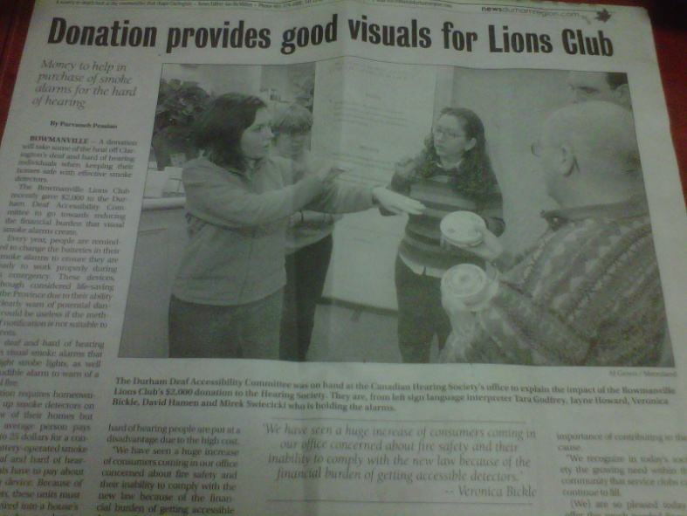
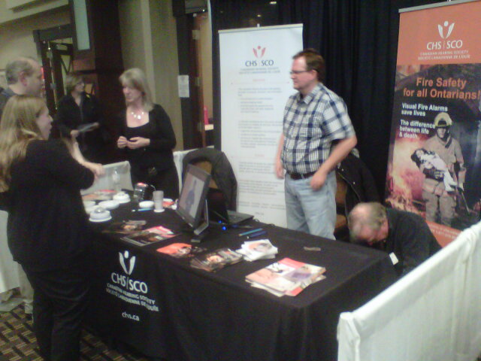
Newspaper article in January 2008 about the Bowmanville Lions Club donation of $2,000 for visual smoke alarms in Oshawa This Week.
At the Fire Prevention Officers Trade Show in Ajax, March 2012.

Slide 11
More Accomplishments!
Better communication with hospitals in Ajax and Oshawa about accessibility.
Better communication with the Durham Region Police about using interpreters.
Durham Region Transit is in the process of installing real-time LED signage on their buses now.
Still advocating for better fire safety and captioning for town hall meetings!

Slide 12
Why Were We Successful?
We had the passion to improve accessibility in the Durham Region.
We chose our priorities and focus on them.
We provided good support, resources and mentoring for each other.
The Canadian Hearing Society, Peterborough & Durham Region made resources available for us to succeed.
Meeting room
Staff to assist with writing letters

Slide 13
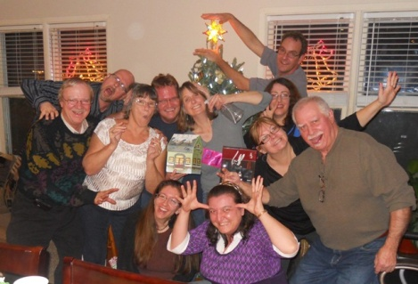
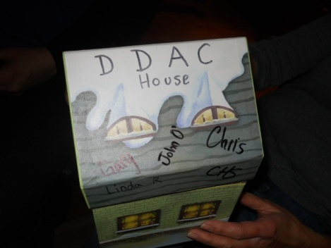
And we had fun!
Annual Christmas and BBQ summer party at various DDAC members’ homes.
Inside jokes and sense of humour!
Christmas Party
December 2011

Slide 14
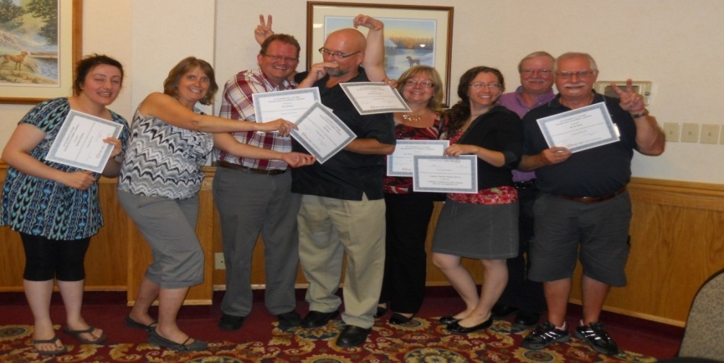
What we hope for the future!
We just had our 5th Anniversary event on September 26, 2012!
We would like to see more Accessibility Committees set up across the province to focus on advocating for our accessibility needs!
We have a new website! Visit us at:
www.dhhcanada.ca/durhamdeafaccess/index.htm

Slide 15
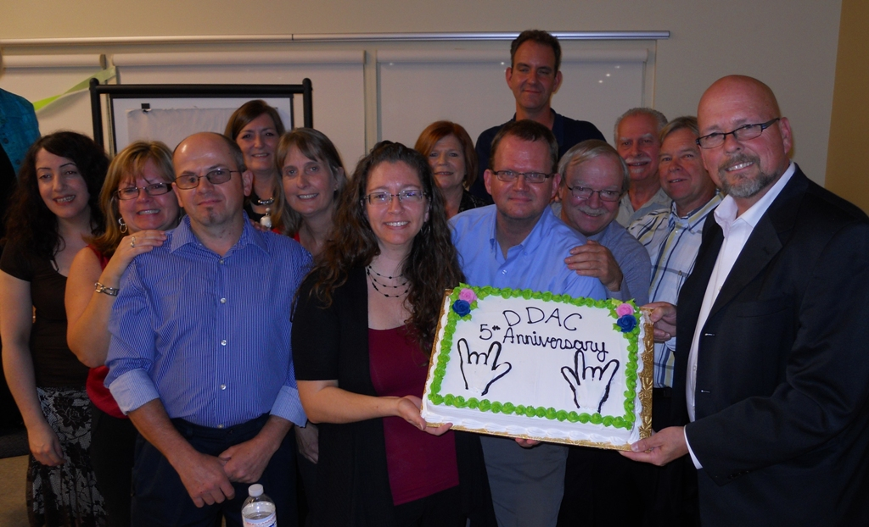
The End!
Questions?
Comments?

